Slide 1
Strings in C++ Advanced Programming, Lecture 3

Slide 2
What is a string?

Slide 3
What is a string?
String is a group of characters.

Slide 4
What is a string?
Do you think that the number 123 is a group of three digits?
String is a group of characters.

Slide 5
What is a string?
String is a group of characters.
- low-level / primitive definition
- focus is more on the characters

Slide 6
What is a string?
String is a group of characters.
- low-level / primitive definition
- focus is more on the characters
At a higher level , a string is a data type for representing and manipulating text data.

Slide 7
What is a string?
String is a group of characters.
- lower level / primitive definition
- focus is more on the characters
At a higher level , a string is a data type for representing and manipulating text data.
What is the difference?
- supports convenient predefined operations
- better memory management
- easier programming etc.

Slide 8
Two types of strings in C++
1. C -type Strings / NULL terminated strings
2. String class from the STL

Slide 9
Two types of strings in C++
1. C -type Strings / NULL terminated strings
2. String class from the STL
C type strings – Uses arrays for storing the chars
– Terminates with null char \0
(also called null-terminated string)

Slide 10
Two types of strings in C++
1. C -type Strings / NULL terminated strings
2. String class from the STL
C type strings – Uses arrays for storing the chars
– Terminates with null char \0
To use c-type strings we need to include the library cstrings in C++
This offers backward compatibility

Slide 11
C-type strings in C++
Example
char str[10]=“Good Day”;

Slide 12
C-type strings in C++
Example
char str[10]=“Good Day”;
G | O | O | D |  | D | A | Y | \0

Slide 13
C-type strings in C++
Can we store or assign a new string in str?
str = “Bad day”
#include<iostream>
using namespace std;
int main(){
char str[10] =“Good Day”;
cout <<str<<endl;
str = “Bad Day”
cout <<str<<endl;
return 0;
}

Slide 14
C-type strings in C++
#include<iostream>
using namespace std;
int main(){
char str =“Good Day”;
cout <<str<<endl;
str = “Bad Day”
cout <<str<<endl;
return 0;
}
Can we store or assign a new string in str?
str = “Bad day”
Not possible because the string is viewed as group of chars

Slide 15
C-type strings in C++
#include<iostream>
using namespace std;
int main(){
char str =“Good Day”;
cout <<str<<endl;
str = “Bad Day”
cout <<str<<endl;
return 0;
}
Can we store or assign a new string in str?
str = “Bad day”
Not possible because the string is viewed as group of chars
So assigning new string to str can be accomplished only by copying the chars one by one. - (strcpy)

Slide 16
C-type strings in C++
String handling functions – to make string manipulation easier.
Sl.No | Function Name | Use
1 | strcpy(s1,s2) | To copy the string s2 to s1
2 | strlen(s) | To find the length of the string s
3 | strcmp (s1,s2) | To compare the string s1 and s2

Slide 17
C-type strings in C++
Problems of c-type strings
They do not define a type in C++ , So no operator support (for copying, comparing, adding etc)
No inherent memory management (security breach)
Fixed size, the programmer has to think a lot about the size of the string.

Slide 18
String stl class
Integrate string type to C++ type system
Creates a dynamic data type – means string instances can grow and shrink at runtime
Eliminates some of the security problems (associated with memory access)
Programming is made easier
Many simple functions and operators are available.

Slide 19
String stl class – How to use?
Include the library string in C++ program
#include <string>
create a string instance/variable to store the data
string str = “Good Day”;
Note that the objects of class string do not necessarily contain the string terminating character '\0’, like C-type strings.

Slide 20
String stl class – How to use?
A string object can be initialized using constructors in various ways.
#include <iostream>
#include <string>
using namespace std;
int main (){
string s0 = "Initial string";
string s1; // Empty string constructor, length of s1 is 0
string s2 (s0); // Copy constructor, constructor Copies string from s0
string s3 (s0, 8, 3); // substring constructor, Copies the portion of str that begins at 8th char and spans 3 chars
string s6 (10, 'x'); // fill constructor, fills the string with n consecutive copies of character c.
string s7 (s0.begin(), s0.begin()+7); // range constructor,Copies the sequence of characters in the range [first,last),
// in the same order.
cout << "s1: " << s1 << "\ns2: " << s2 << "\ns3: " << s3;
cout << "\ns4: " << s4 << "\ns5: " << s5 << "\ns6: " << s6;
cout << "\ns7: " << s7 << '\n';
return 0;
}

Slide 21
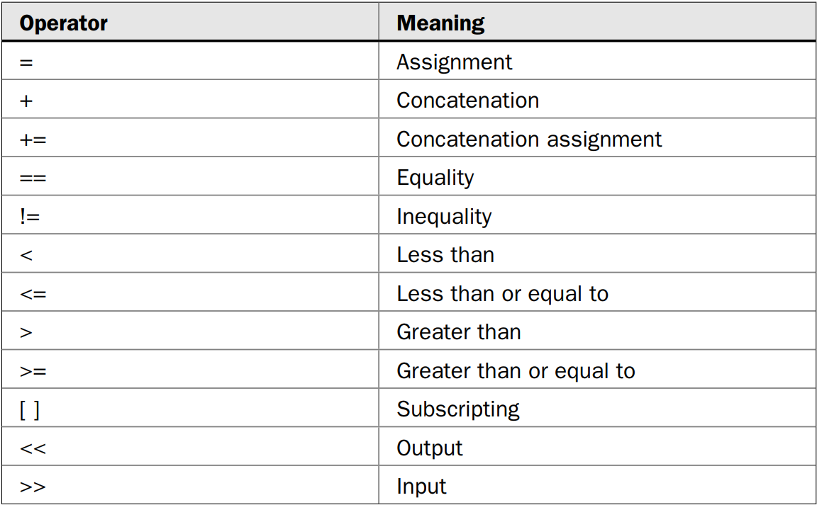
String stl class – Operators
A number of operators have been overloaded for strings.

Slide 22
String stl class – Methods
A number of methods have been defined for strings
Sl.No | Function Name | Use
1 | find | Returns the index at which the first occurrence of a substring or character is found
2 | find_last_of | Searches the last occurance
3 | Append | Appends a string at the end of original string
4 | Insert | Insert a string
5 | Push back | Adds a character to the end of the invoking string

Slide 23
String stl class – Methods
Reference site for strings
http://www.cplusplus.com/reference/string/string/

